Slide 1
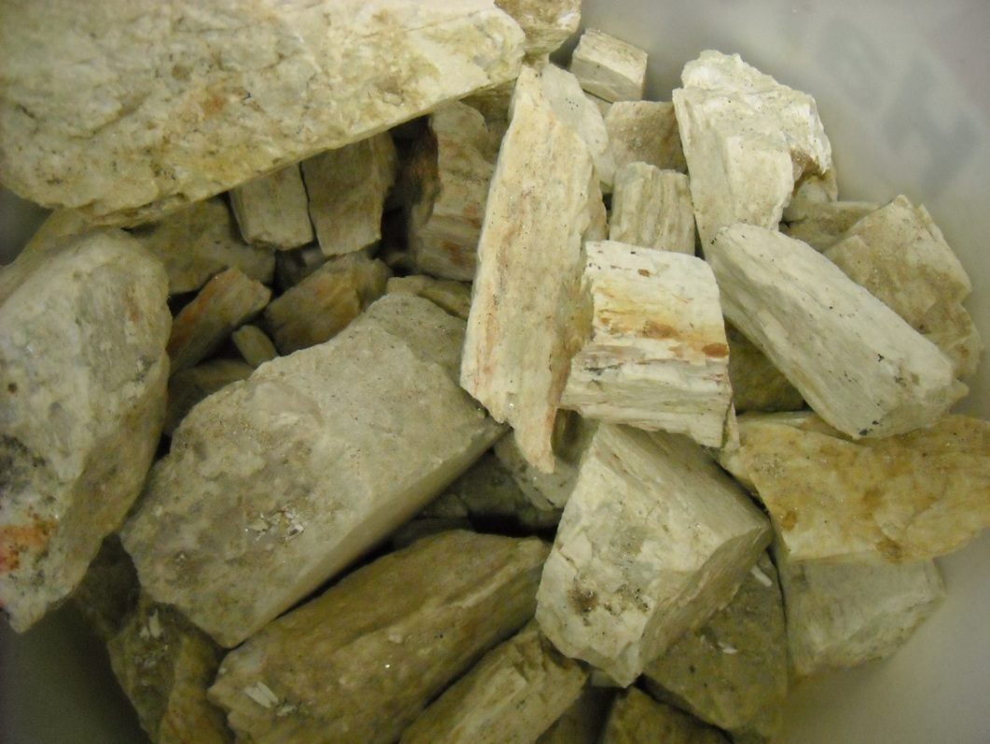
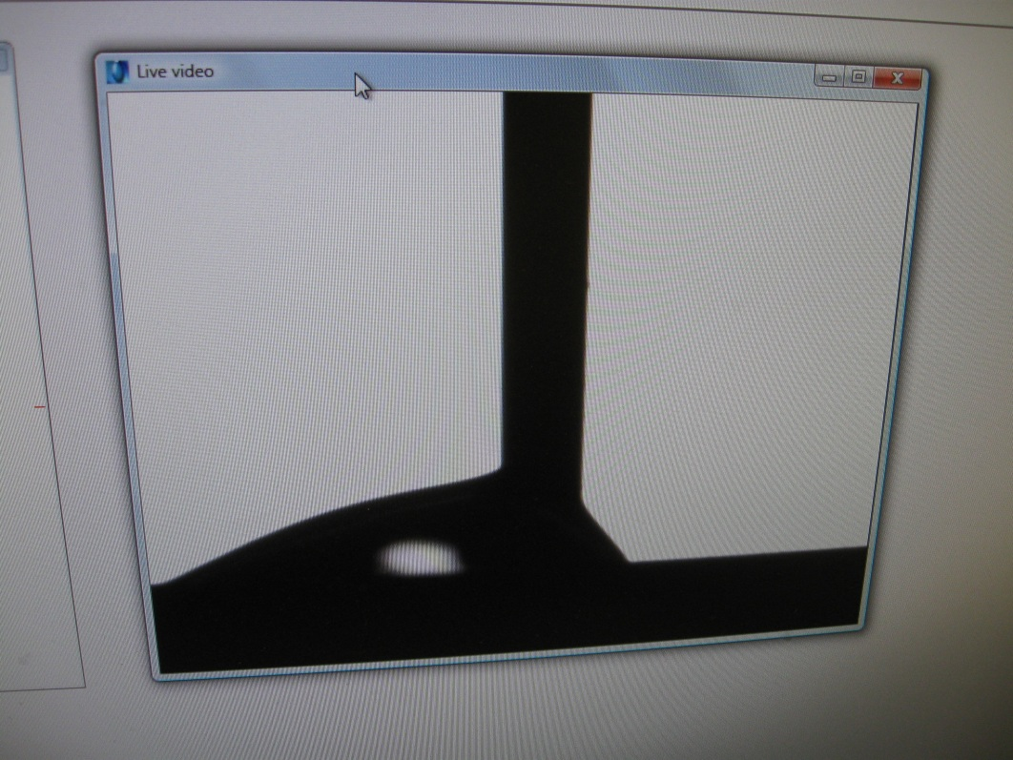
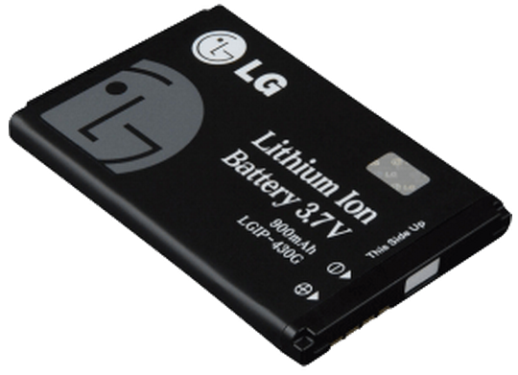
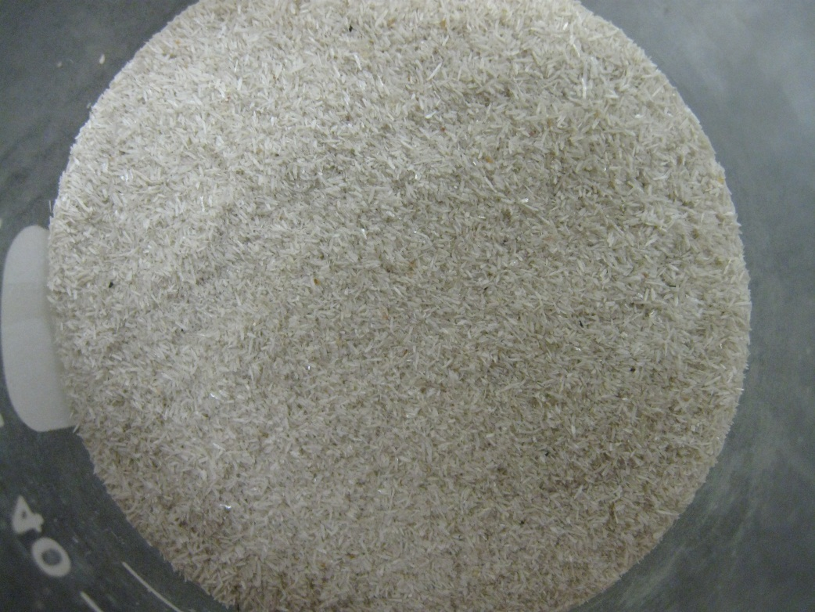
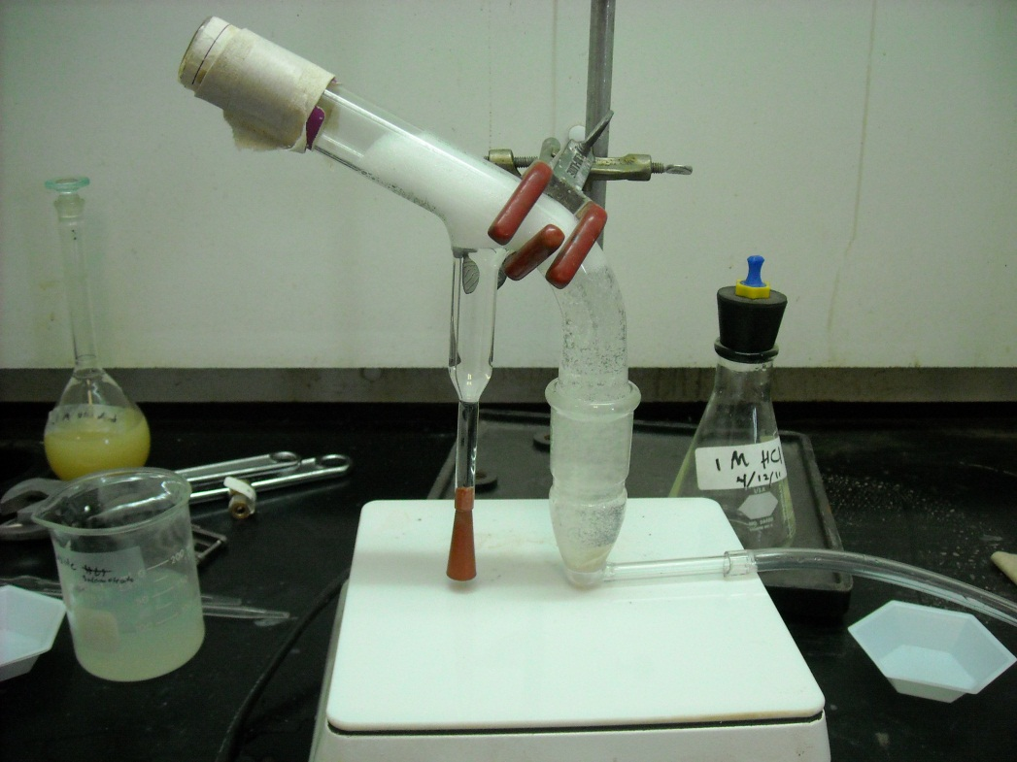
Recovery of Lithium from Low Grade Resources
Carly Merling (University of Dayton)
Faculty Advisors: Dr. William Cross, Dr. Jon Kellar
Research Experience for Undergraduates – Summer 2012
Introduction
Procedure
Results
Conclusion
Lithium is used in the production of batteries, glass, ceramics, and aluminum. It has the potential to be very important in the future for the manufacturing of batteries.
Only one company in the United States produces lithium compounds, even though the United States is the primary consumer of all lithium production.
Sources of lithium in the American ores tend to be low grade or low percent concentration of the desired mineral.
Spodumene samples were collected from local mines in Keystone, South Dakota.
A sample of spodumene was polished and the contact angles were measured using a contact angle goniometer.
The spodumene was ground by hand with a mortar and pestle then screened to get particle sizes between 388 and 177 microns.
1 gram samples were placed in the Hallimond tube flotation cell along with a magnetic stir bar and a solution of sodium oleate at pH 9.
Flotation trials were run for 8 minutes with 0.75 cc/sec nitrogen using different concentrations of sodium oleate.
The tailings and the floated materials were collected separately, dried on watch glasses, and then weighed.
The percent recovery and contact angles were determined for each trial.
X-Ray Diffraction was performed on the spodumene sample (starting mineral for flotation)
X-Ray Diffraction demonstrated a strong correlation between the spodumene samples collected and reference spodumene spectrum.
This indicated the sample is essentially pure spodumene.
A broad range of concentrations were used in the trials to investigate possible relationships with contact angle and percent recovery by flotation
The standard deviation for the 0.001M concentration of sodium oleate was 6.2 percent recovery.
X-Ray Diffraction demonstrated that the samples were essentially pure spodumene.
From concentrations of 0.001-0.004M there is a consistent correlation between the percent recovery of spodumene and the contact angle of spodumene.
However, at the extreme ends of the concentrations of flotation, the percent recovery significantly declined while the contact angle remained relatively high.
The extreme low and high concentration contact angles were unexpected and could be due to surface roughness and or precipitation of metal oleate species at the mineral surface.
Left: collected spodumene samples
Right: dropping liquid on sample surface for contact angle
X-Ray Diffraction of spodumene sample with reference spodumene spectrum
Future Work
Broader Impact
More trials can be run varying the concentration of sodium oleate, pH levels, flotation time, and spodumene sample size
The contact angles can be measured as a function of time
Large scale froth flotation can be run on the samples to go beyond Hallimond tube flotation
In order to reduce the United States’ dependency on foreign resources and increase local production, effective methods of local recovery of lithium can be developed.
Local production of lithium will be cheaper because it does not have an imported materials tax and the shipping costs are reduced.
Left: Ground Spodumene used for flotation
Right: Hallimond tube flotation run
Acknowledgments
Objective
The objective of this project is to develop an effective process to separate low-grade lithium samples from spodumene into high grade products which can be used in industry.
Dr. William Roggenthen
Dr. Edward Duke
Mr. Bob Hanson
Mr. Rob Cook
Mr. Kelsey Fitzgerald
National Science Foundation Grant 1157074
Flotation of spodumene samples and contact angles with different concentrations of sodium oleate solutions at pH 9

